Slide 1
Generic object tracking benchmark

Slide 2
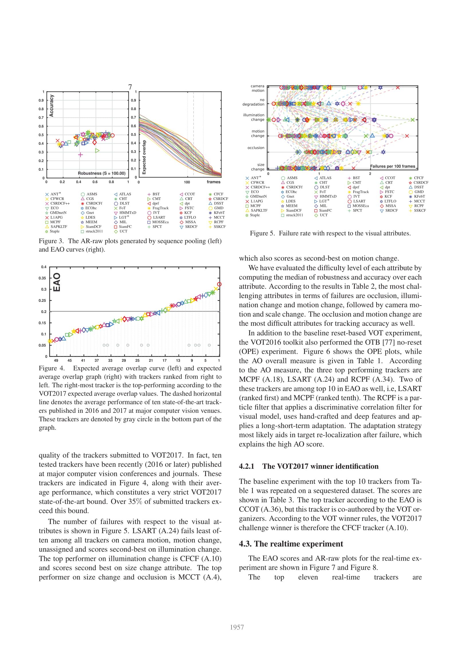
Benchmarking
One Shot Tracking definition
Visual Object Tracking challenge
  Standardized evaluation
  Public dataset
    Covers challenging scenarios
    Scenario descriptor vector for images
  Real-time challenge
    Faster than input
  Overall challenge
    EAo

Slide 3
Benchmarking
Evaluated in terms of
  Accuracy
    Average overlap
  Robustness
    ∑ of failures and resets
  Area under curve

Slide 4
Benchmarking
Current dataset
  Covers scenarios
  Gives too much preference to “simple tracking” scenarios/results are skewed by dataset
Tracker needs to met specific purpose
  Trade-off between speed, accuracy, robustness, specific scenario performance
State of the art Generic Object Trackers
  Generative vs Discriminative classifiers
  Trade-off between speed and accuracy
  Evaluate which is suitable for intended purpose

Slide 5
Benchmarking
Real-time winner
  SiameseFC tracker
    Amongst highest EAO, accuracy and robustness
    Quoted 50-100 FPS for 640x480 input (NVIDIA TITAN X)
Overall winner
  CFCF
    Highest EAO, amongst most robust and accurate
    On NVIDIA Tesla K40 GPU = ~1-2FPS (200x200)
SiameseFC tracker ~ 20% less robust than CFCF, but ~ as accurate ?
Are we efficiently utilising the sensor and hardware?
  Object detection runs > 50 FPS = more comprehensive knowledge of environment

Slide 6
Towards scene awareness
  Object detection
    Given frame, produce annotations of class labels, confidence and bounding
  Object localization
    Given frame, produce 5 class labels and bounding boxes (decreasing confidence)
  Object detection video
    Given video sequence, produce frame number, class labels, confidence scores and bounding box
  Approaching/exceeding human capability
    More productive utilization of hardware?
  3D reconstruction of environment – Detect, locate, incorporate lightweight temporal tracking?
    More efficient?

